Slide 1
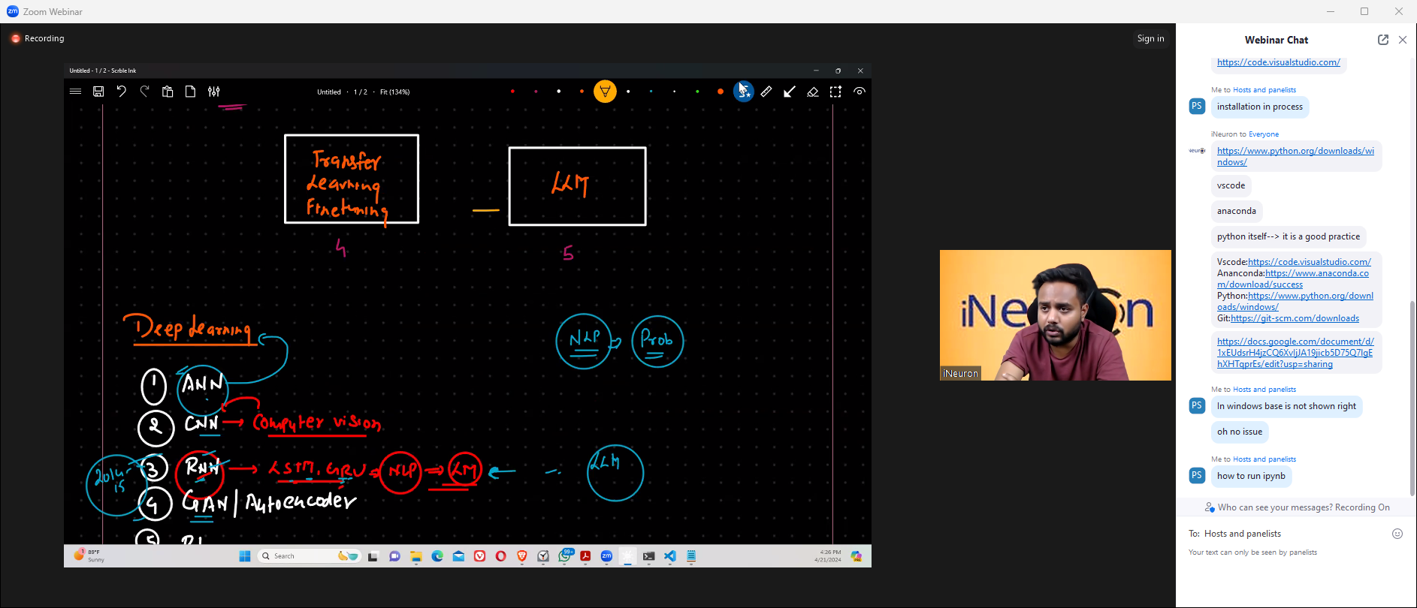

Slide 2
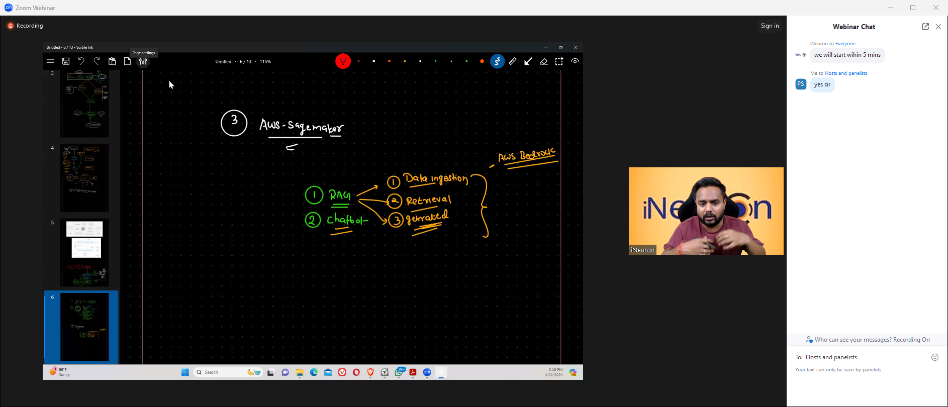

Slide 4
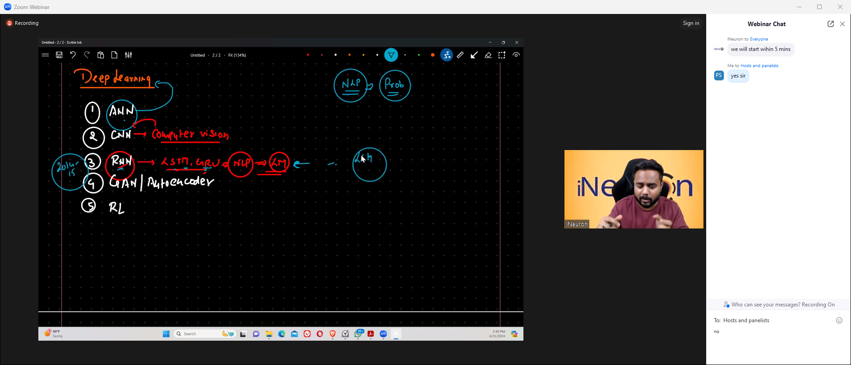
ANN – Artificial Neuron Network
CNN – Convolution Neural Network
RNN – Recurrent Neural Network
GAN – Generative Adverbial Networks
RN → Reinforced Learning

Slide 5
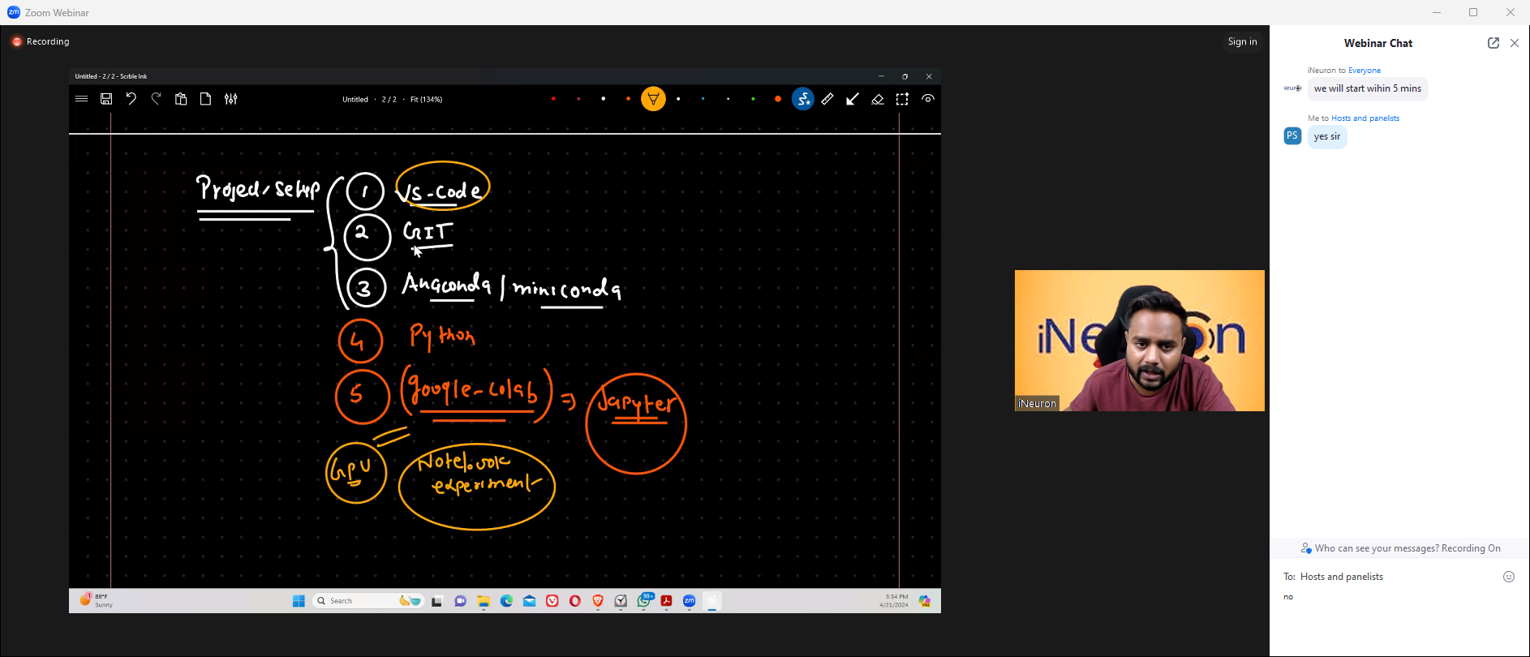

Slide 6
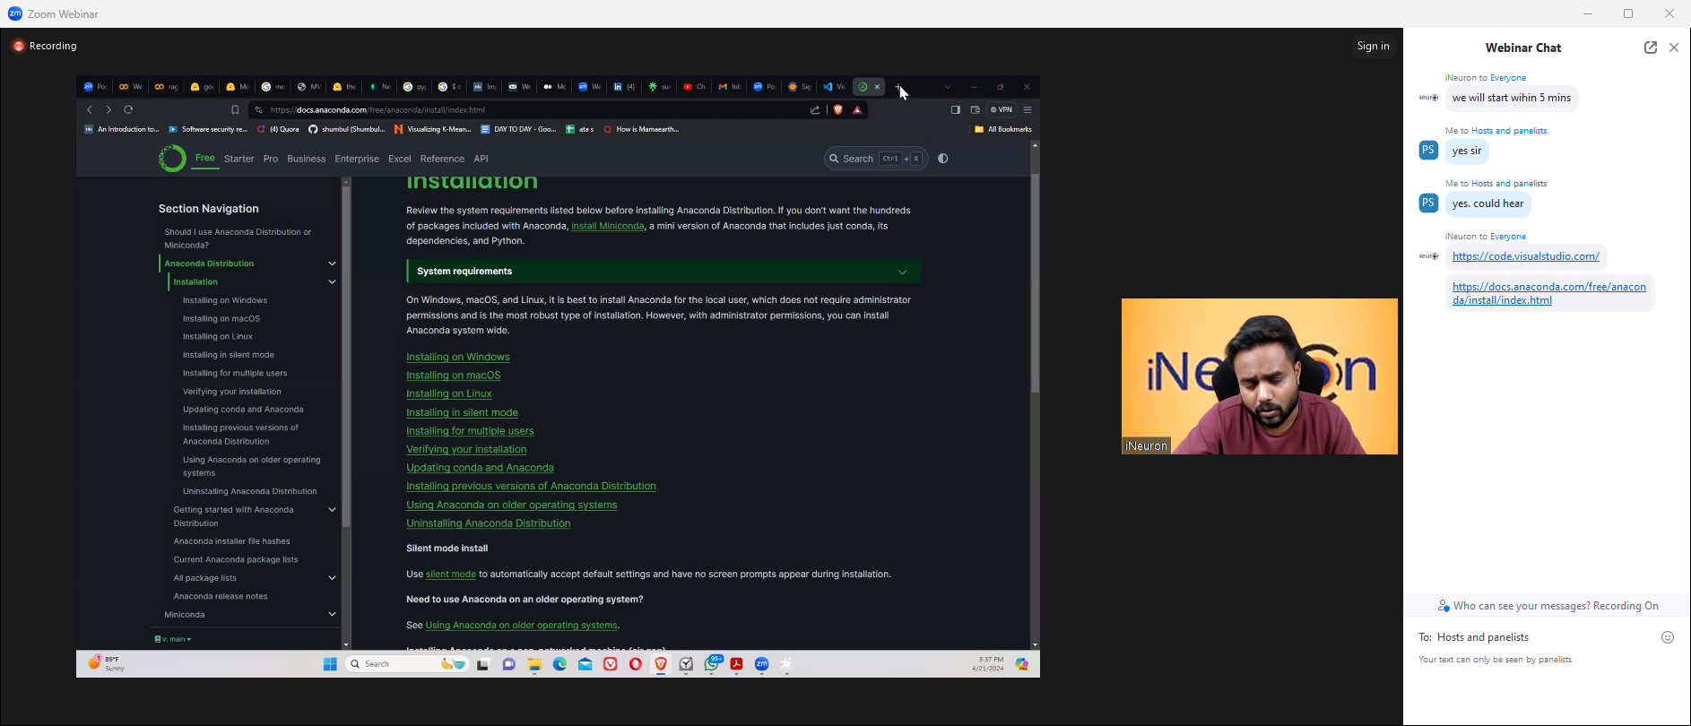

Slide 7
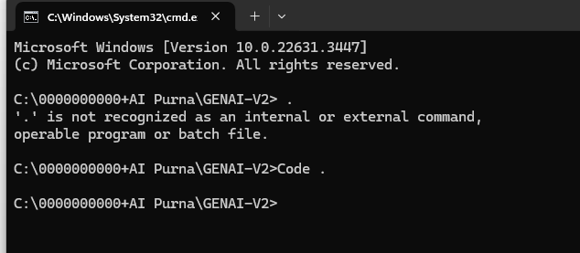

Slide 8
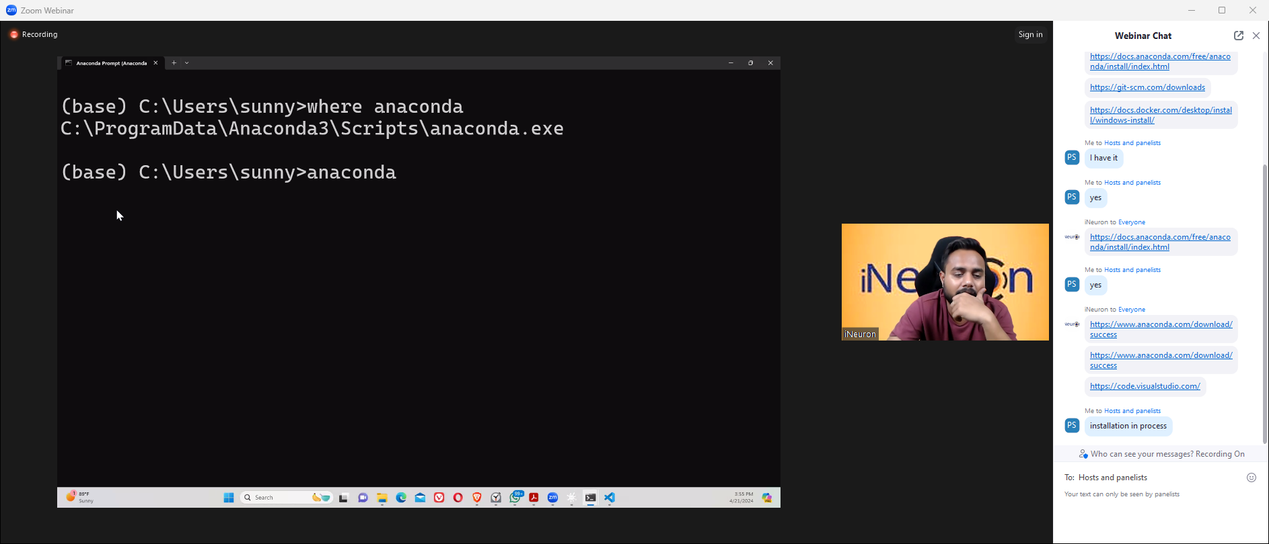

Slide 9
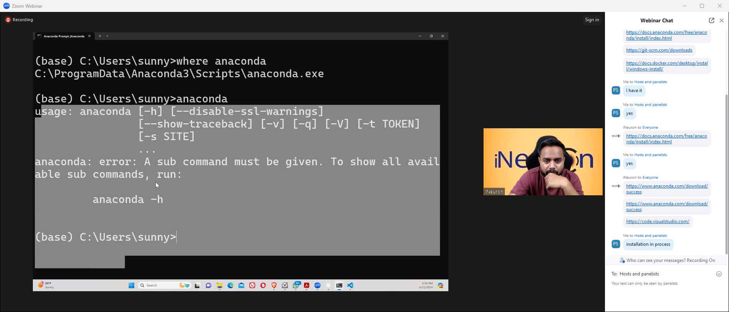

Slide 10
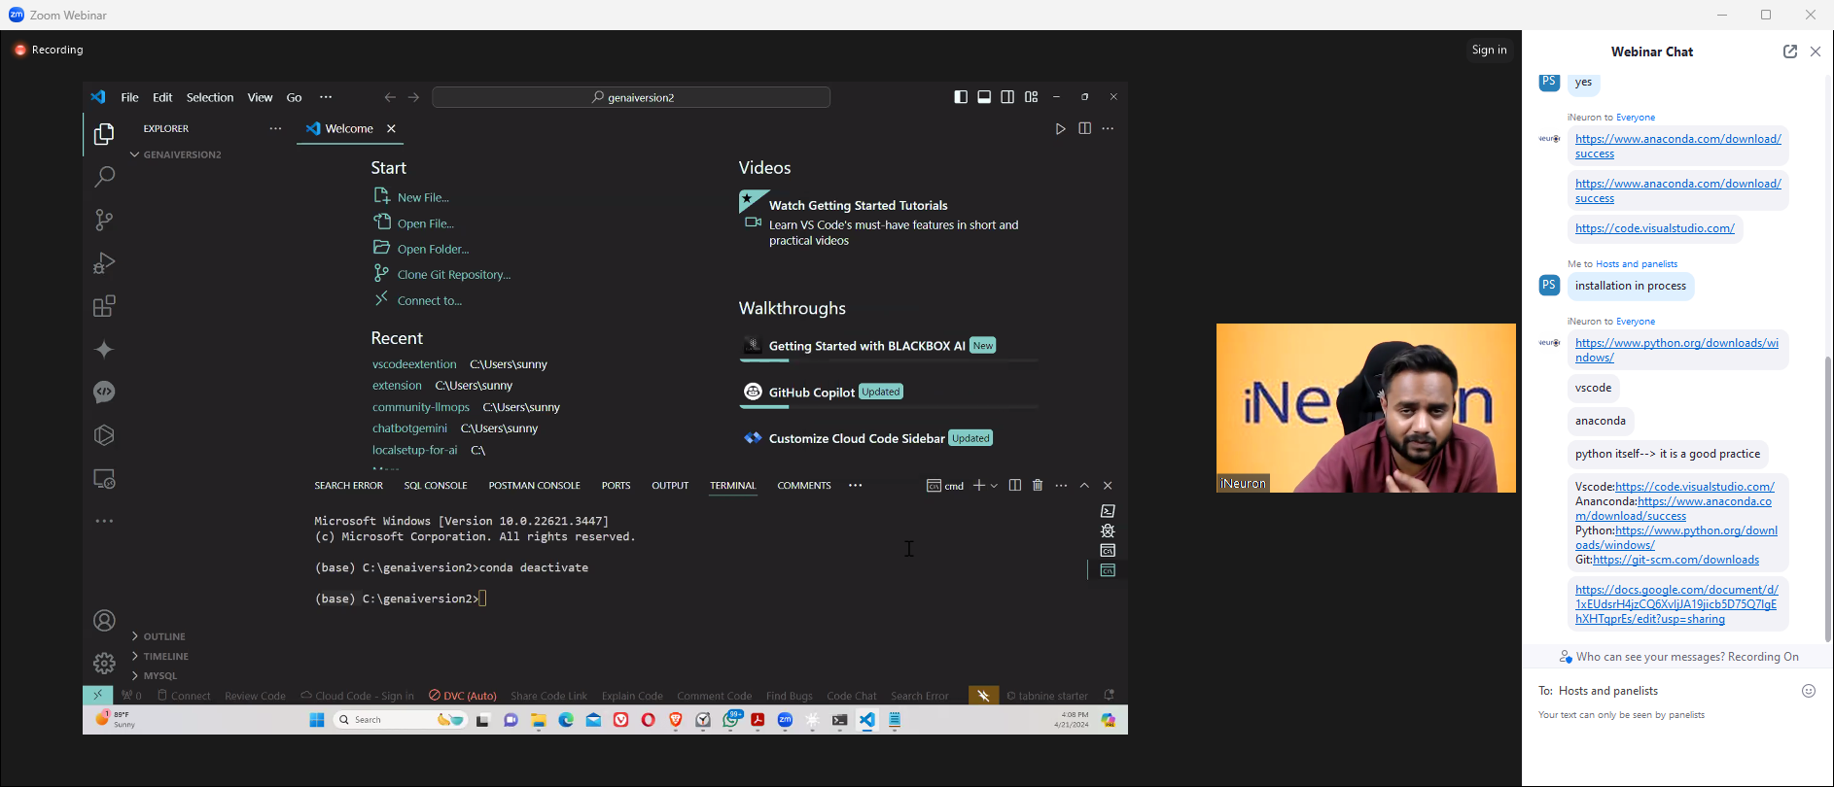
View -- > Command Pallette → Python Select Interpretor --→ Python (base ) Anaconda…

Slide 11
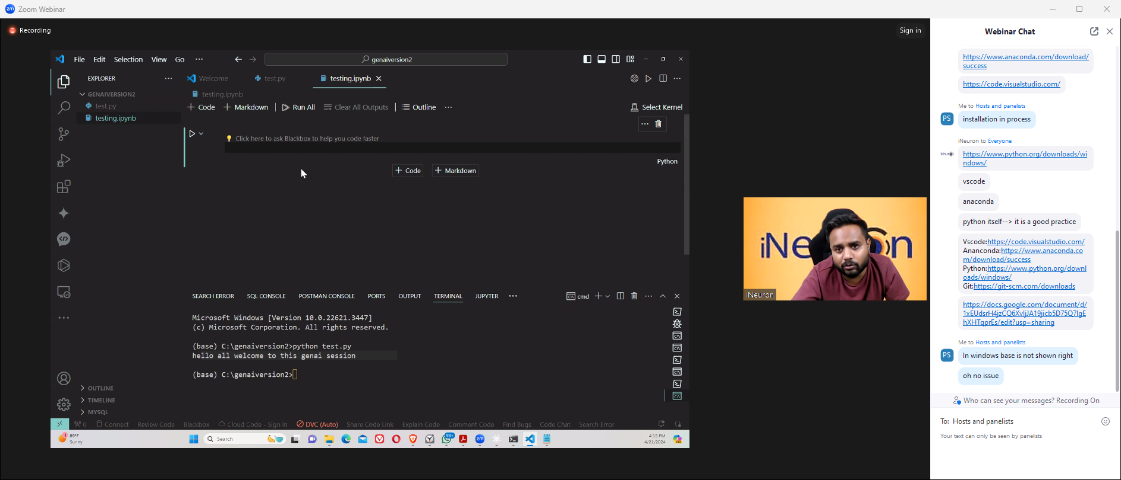
1.04.00 see
testing.ipynb

Slide 12
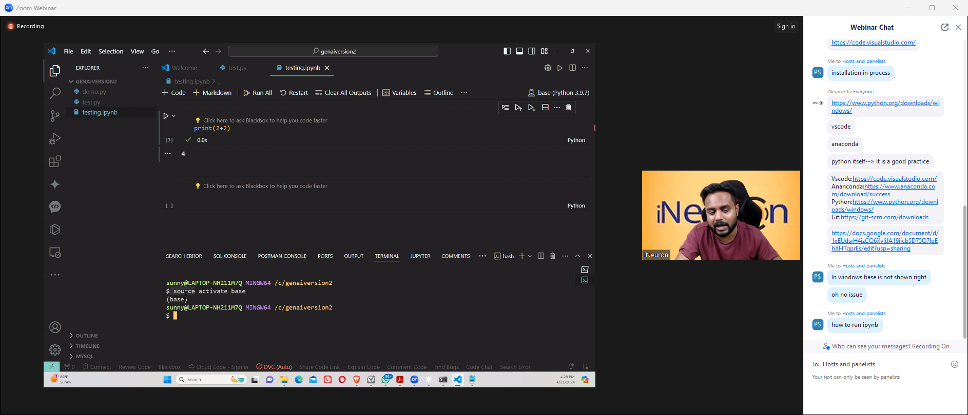
Source activate bash

Slide 13
From 1 hour 4 minutes go again for running ipnub

